Slide 1
A Game of Financial Choices
for Grades 6-8

Slide 2
HOW TO PLAY
Congratulations! You've just graduated from college and
landed your first job. You're making a yearly salary of $55,260.
After taxes, that works out to $3,857 a month (your net income).
As you start out your adult life, you'll have some decisions to make.
Follow the steps on the path to make a series of financial choices.
Record those choices on your Check Register. As you subtract for different expenses, make sure your balance doesn't dip below $0. If it does, press the back button and make different choices. Good luck!

Slide 3
Notes:
[GAME BOARD Note: this slide art will be repeated on every other slide]
ILLUSTRATION NOTES: Full color illustration. I'd like to see a game board similar to the winding path in A Tiger's Tale but a road. Bright sunny sky and grass. Use the Game of LIFE for inspiration for illustration along the path (think: houses, banks, libraries, stores). There should be 12 stops along the way. We'll also need a token piece that moves after each choice. Let's make it a car.
DESIGN NOTE: The illustration for the token piece needs to be its own piece of art. We will place in correct space as the slides move through the game.

Slide 4
CHOICE #1:
SAVINGS
It's important to save for the future and for unexpected expenses.
How much do you want to put away? Here are your options:
Savings Account
Savings Account
Online Savings Account
$50 monthly deposit
Earns a lower rate of interest
To make this choice, subtract $50.
$100 month deposit
Earns a higher rate of interest
To make this choice, subtract $100.
$150 monthly deposit
Earns highest interest rate
Limited to three withdrawals per month
To make this choice, subtract $150.
Make your selection and record it as a Payment on your Check Register.
Notes:
DESIGNER NOTES: For the choice slides, I think we'll need some background art. As in A Tiger's Tale, I'd like to see some kind of border that reflects the game board art. Each choice can have a piece of spot art (suggestions noted throughout).

Slide 6
CHOICE #2:
HOUSING
Time to move into your new apartment! Here are your options:
1-Bedroom Apartment
2-Bedroom Apartment
with Roommate
2-Bedroom Apartment
with No Roommate
1 bathroom
Community pool
To make this choice, subtract $1,352.
2 bathrooms
Split rent and utilities
To make this choice, subtract $676.
2 bathrooms
Assigned parking
To make this choice, subtract $1,520.
Make your selection and record it as a Payment on your Check Register.

Slide 8
CHOICE #3:
UTILITIES
Bills are due! If you have a roommate, you get to split the cost.
Utilities
Water bill $40
Gas/electric $100
Sewer/garbage collection $20
If you live alone, subtract $160. If you have a roommate, subtract $80.
Make your selection and record it as a Payment on your Check Register.

Slide 9
Uh-oh! Your car broke down. It will cost $300 to fix.
Record $300 as a Payment on your Check Register.

Slide 11
CHOICE #4:
FOOD
Are you cooking at home or going out? Here are your options:
Meals at Home
Dining Out and Fast Food
Groceries $250
To make this choice, subtract $250.
Fast Food
30 breakfasts @ $4 each = $120
30 lunches @ $5 each = $150
26 dinners @ $9 each = $234
To make this choice, subtract $573.
Dining Out + 15% tip
4 dinners @ $17.25 each = $69
(See the math: Each dinner out costs $15 + $2.25 tip = $17.25)
Half Meals at Home,
Half Dining Out
Dining out $150
Groceries $200
To make this choice, subtract $350.
Make your selection and record it as a Payment on your Check Register.

Slide 13
CHOICE #5:
TRANSPORTATION
Think about how you want to get to and from work and other places you need and want to go. Here are your options:
Public Transportation + Occasional Ride Shares
Used Economy Car
New Car or SUV
You own this vehicle
92,221 miles
Stereo
Airbags
Power locks and windows
Uses unleaded gas
To make this choice, subtract $376.
You own this vehicle
Low miles
High-end stereo and backup camera
Airbags
Power locks and windows
Uses premium gas
To make this choice, subtract $800.
Monthly transit pass
Unlimited rides
30 days
PLUS, 3 ride shares a week
To make this choice, subtract $200.
Make your selection and record it as a Payment on your Check Register.

Slide 15
CHOICE #6:
EMERGENCY SAVINGS
Just about any emergency can pop up at any time. If you regularly
save money and have reserves to deal with sudden expenses,
then you’ll be in better shape during difficult times.
Emergency Savings Fund
You can contribute up to 10% of your paycheck
To make this choice, decide what percentage (1% to 10%) you want to contribute. Multiply by your net monthly income (you can use a calculator!) to figure out how much to subtract. For example, for 2%, you would subtract $77 (0.02 x $3,857 = $77.14 or $77 rounded).
Make your selection and record it as a Payment on your Check Register.

Slide 16
Happy birthday! Your friends threw you a birthday party and gave you $250. Record $250 as a Deposit on your Check Register.

Slide 18
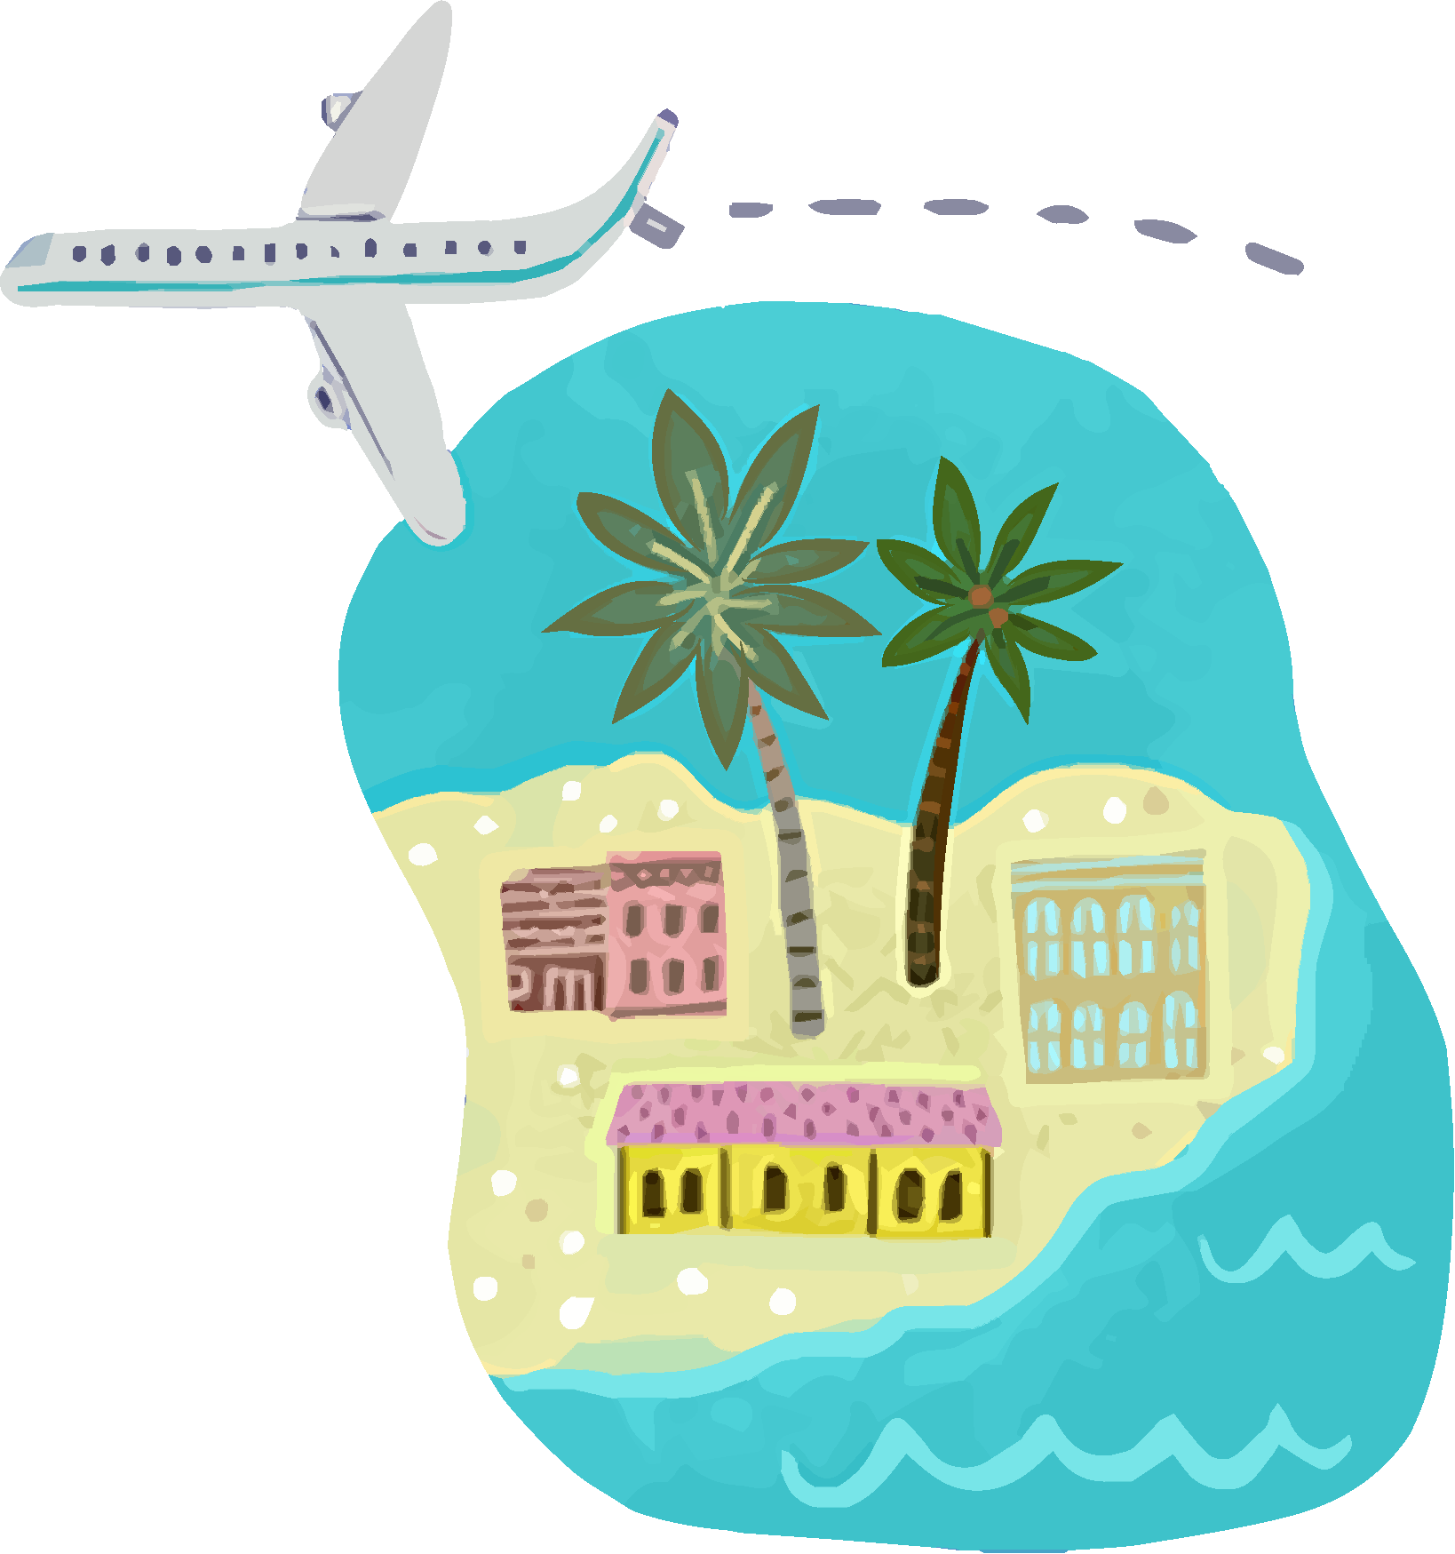
CHOICE #7:
VACATION
Gotta have a little fun! Here are your options:
Light Spender
Moderate Spender
Big Spender
You find free community activities, enjoy outdoor activities, and maximize services you’ve already paid for, like cable TV
To make this choice, subtract $100.
You enjoy blockbuster movies, road trips, and concerts
You save to go to a major league sporting event twice a year
To make this choice, subtract $200.
You rarely say no to fun with friends
You take exotic vacations and have to save more
To make this choice, subtract $300.
Make your selection and record it as a Payment on your Check Register.

Slide 20
CHOICE #8:
SUBSCRIPTIONS
Books, music, and movies ... oh, my! Here are your options:
Light Spender
Moderate Spender
Big Spender
Watch network TV
Listen to free streaming music app with ads
Enjoy free books, movies, and music from your local public library
No cost for this choice!
Subscribe to basic cable TV $30
Subscribe to an ad-free music-streaming app $10
Subscribe to a monthly e-book service, which includes a limited number of books and magazines for a flat rate of $10
To make this choice, subtract $50.
Subscribe to premium cable TV including the sports package $90
Subscribe to a premium internet radio service $15
Buy all the latest novels and magazines $20
To make this choice, subtract $125.
Make your selection and record it as a Payment on your Check Register.

Slide 22
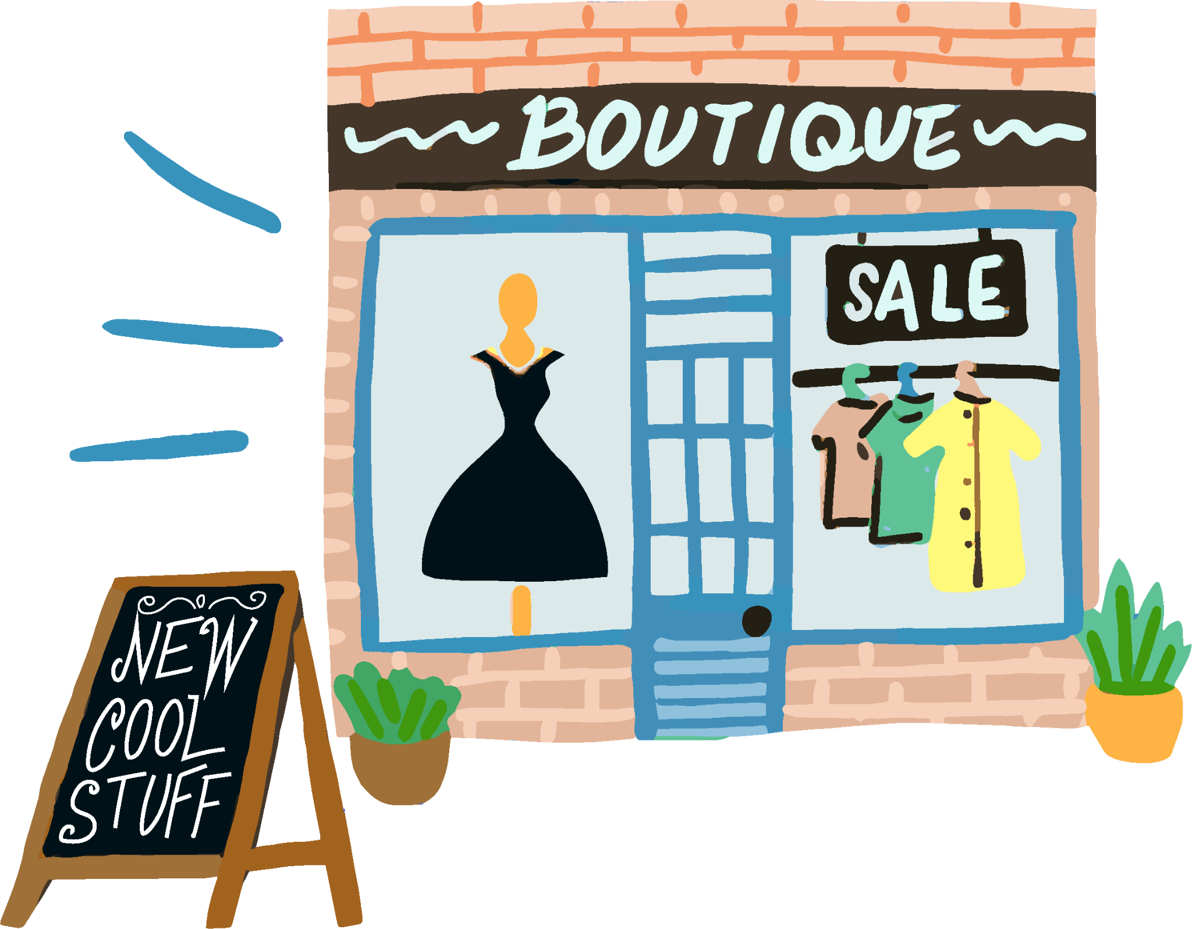
CHOICE #9:
CLOTHING
You need clothes for your new job! Whether you shop Online or in person, here are your options:
Light Spender
Moderate Spender
Big Spender
You buy moderately priced clothing as needed
To make this choice, subtract $125.
You enjoy fashion, but you know your limits
To make this choice, subtract $200.
Fashion is your life!
To make this choice, subtract $350.
Make your selection and record it as a Payment on your Check Register.

Slide 24
CHOICE #10:
SECOND JOB
Time for a reality check! If your balance is under $200 at this point in
the game, you must get a side hustle. Pick the type of job you want and
the number of days per week you’ll work. Here are your options:
Ride-Share Driver
Restaurant Server
Pizza Delivery
Net Monthly Paycheck
2 days/week $320
3 days/week $480
4 days/week $640
Net Monthly Paycheck
2 days/week $360
3 days/week $480
4 days/week $600
Net Monthly Paycheck
2 days/week $528
3 days/week $704
4 days/week $880
Make your selection and record it as a Deposit on your Check Register. If you had a balance over $200, you get to skip this choice!

Slide 26
CHOICE #11:
CELL PHONE
Choose a cell phone plan! Here are your options:
Basic Plan
Upgraded Plan
Unlimited 5G
To make this choice, subtract $70.
Unlimited 5G
Premium network access
To make this choice, subtract $90.
Make your selection and record it as a Payment on your Check Register.

Slide 28
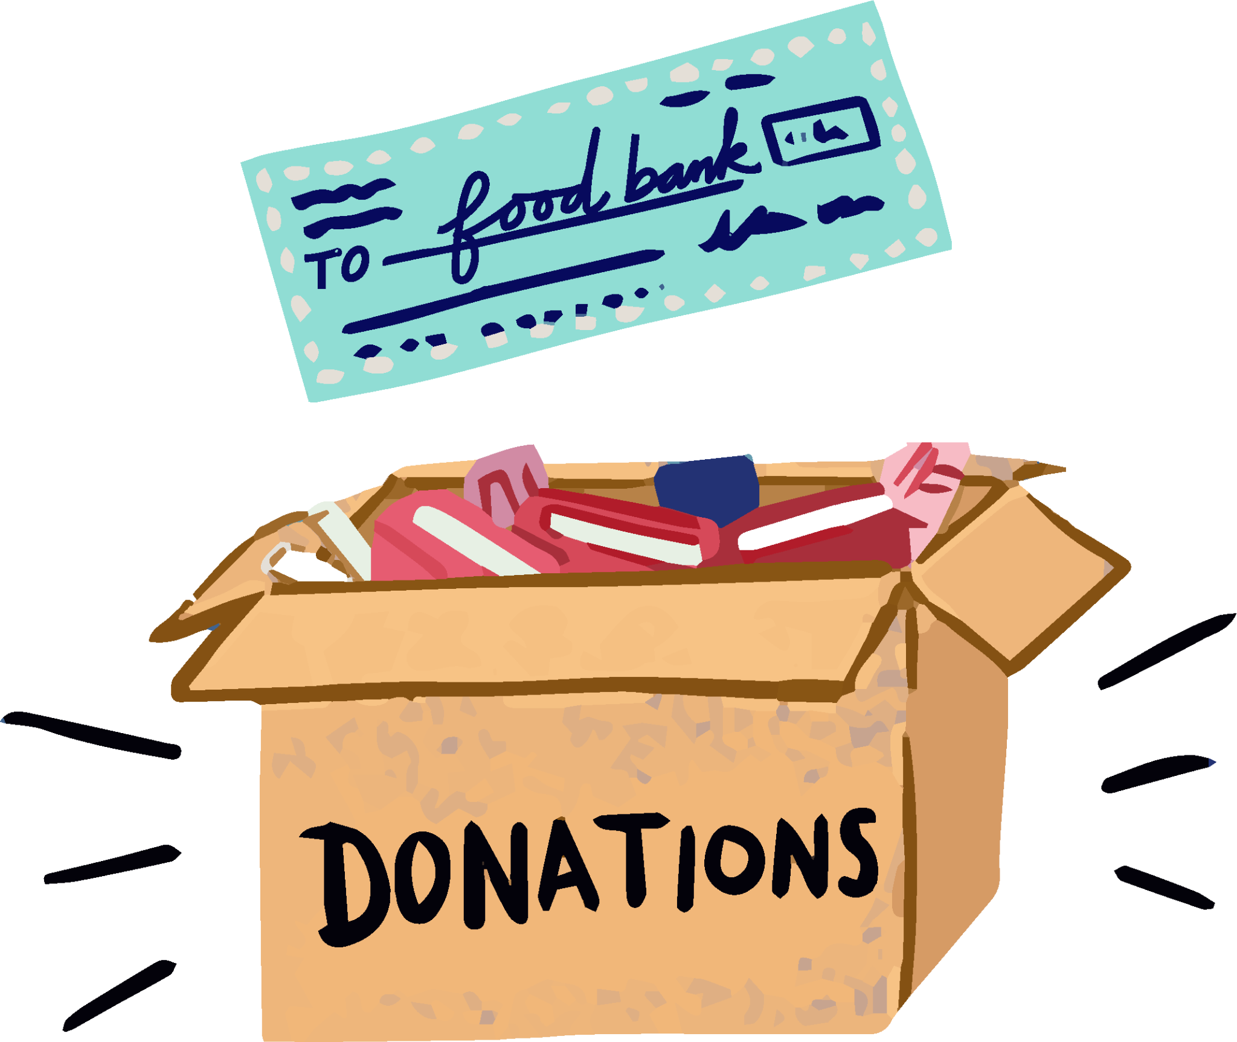
CHOICE #12:
CHARITABLE GIVING
It's important to give back. Find your birth month to decide
what percentage of your paycheck will go to charity.
Percentage
January or July 1%
February or August 2%
March or September 3%
April or October 4%
May or November 5%
June or December 6%
Multiply the percent by your net monthly pay (you can use a calculator!) to get your total.
(For example, if you were born in July, you donate 1%, or $39 (0.01 x $3857 = $38.5 or $39 rounded).
Make your selection and record it as a Payment on your Check Register.

Slide 29
You're all finished! Take a look at your ending balance. Is it over $200?
Then you're in good shape! If not, you may want to reconsider your choices. Remember that with a positive cash flow, you have money for discretionary expenses (that means spending on non-essential items rather than needs). You could also put that money into savings, invest it, or give the money
to a charitable organization.

